Slide 1
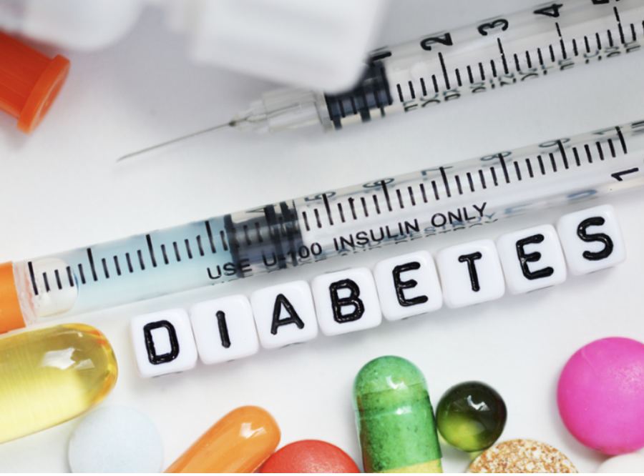
Predicting Diabetes with Machine Learning
(Group 9)

Slide 2
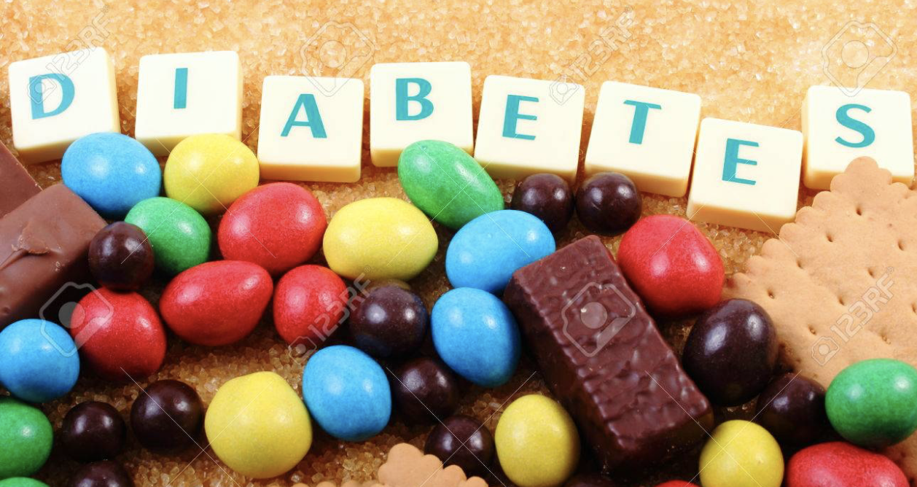


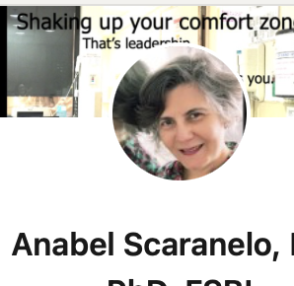
WHO WE ARE ?
The Sweet
DATA Detectives
ZAID AL DULAIMI - TORONTO
LINTU BABY – WOODSTOCK
ANABEL SCARANELO – TORONTO

Slide 3

Disclosures
We do not have any financial interests.

Slide 4
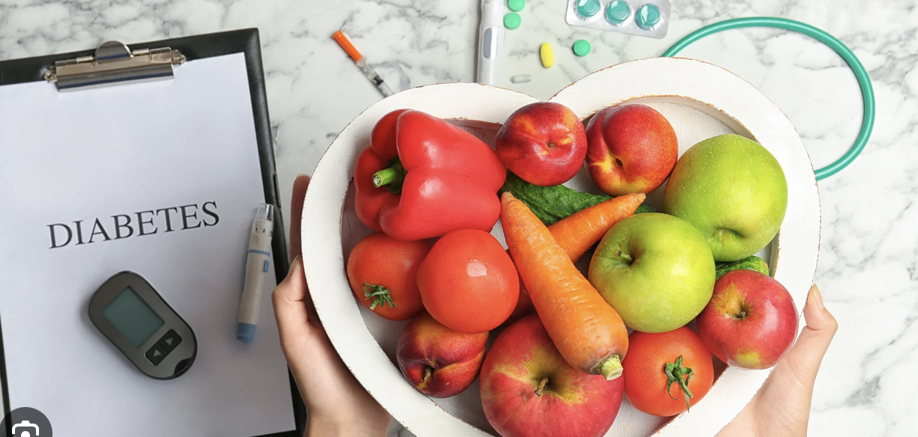
Learning Objectives
After this presentation you will know…
A brief overview about Diabetes Mellitus (DM),
a very bad disease.
How we could train different
Machine learning models
to achieve the best accuracy to determine if someone could be at risk.

Slide 5

Our goals
Identify
Databases that are accurate and pre-process the data.
Classify
and Identify DM patients by using machine learning algorithms.
Build
A model using supervised machine learning algorithms that predict DM.

Slide 6
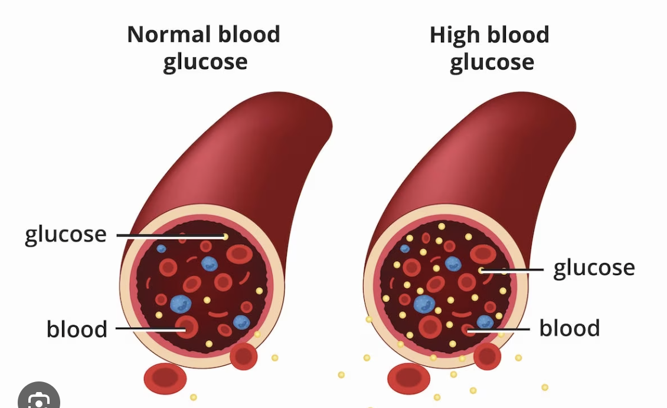
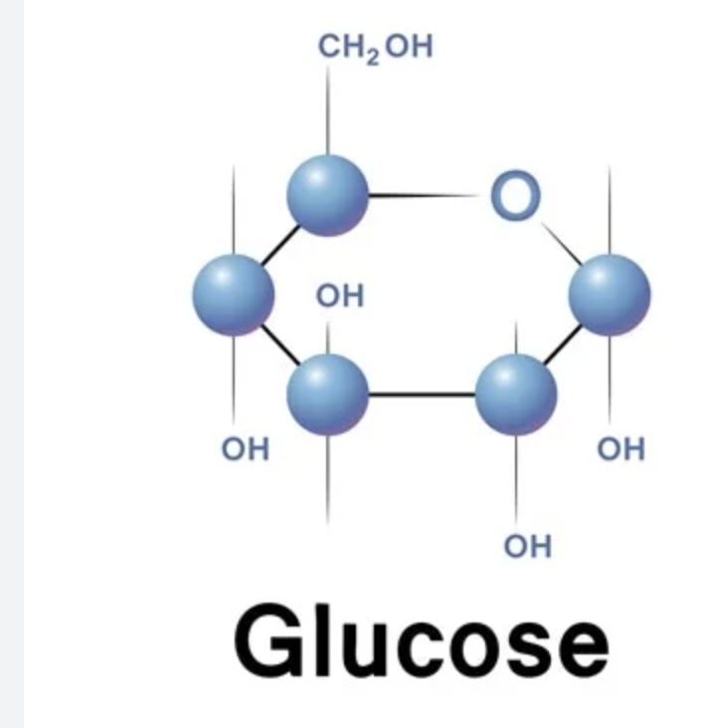
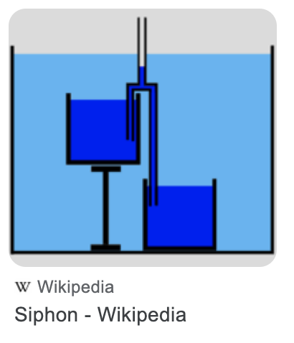

Brief Overview:
Diabetes Mellitus

Slide 7
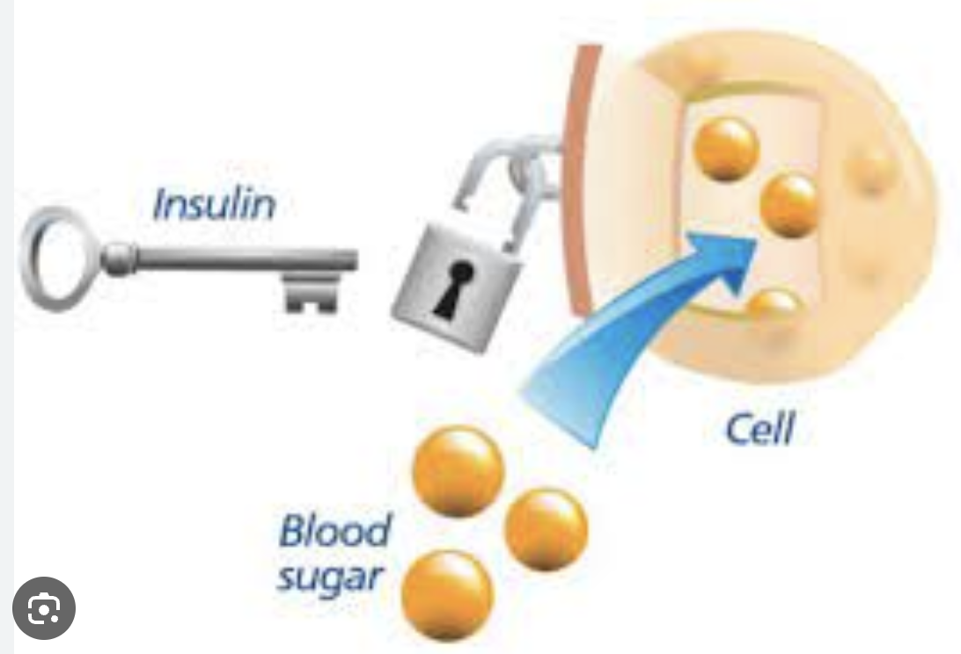
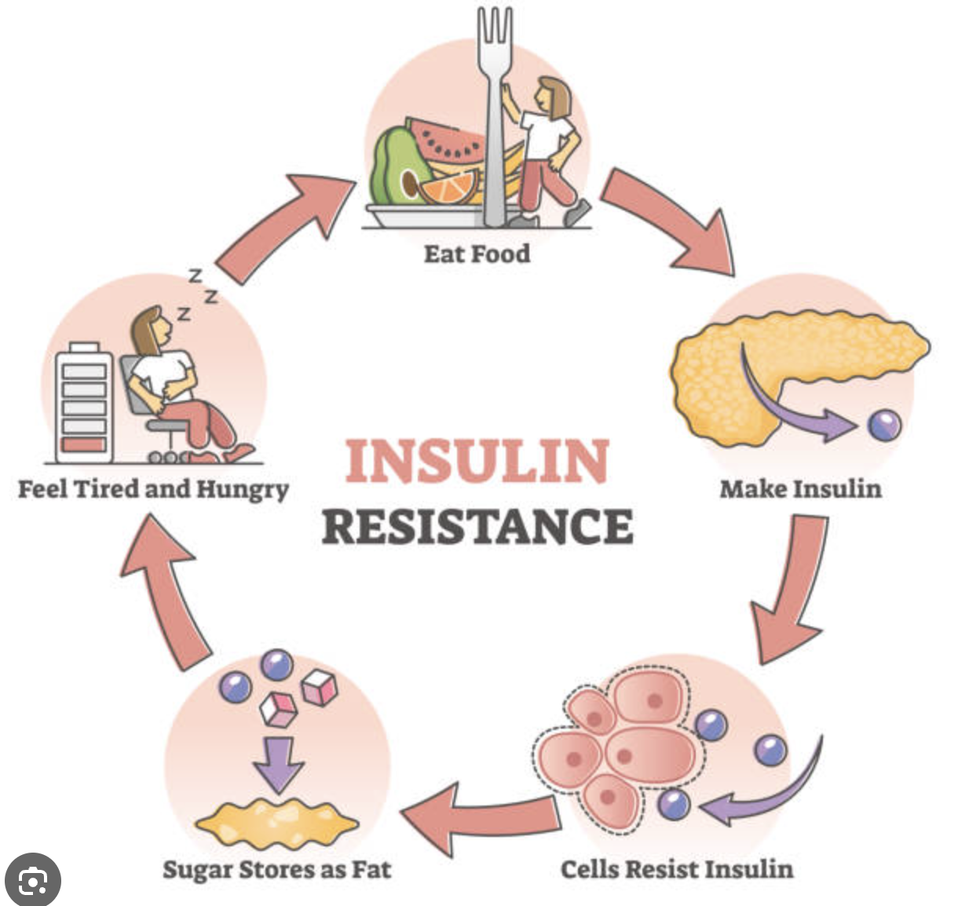
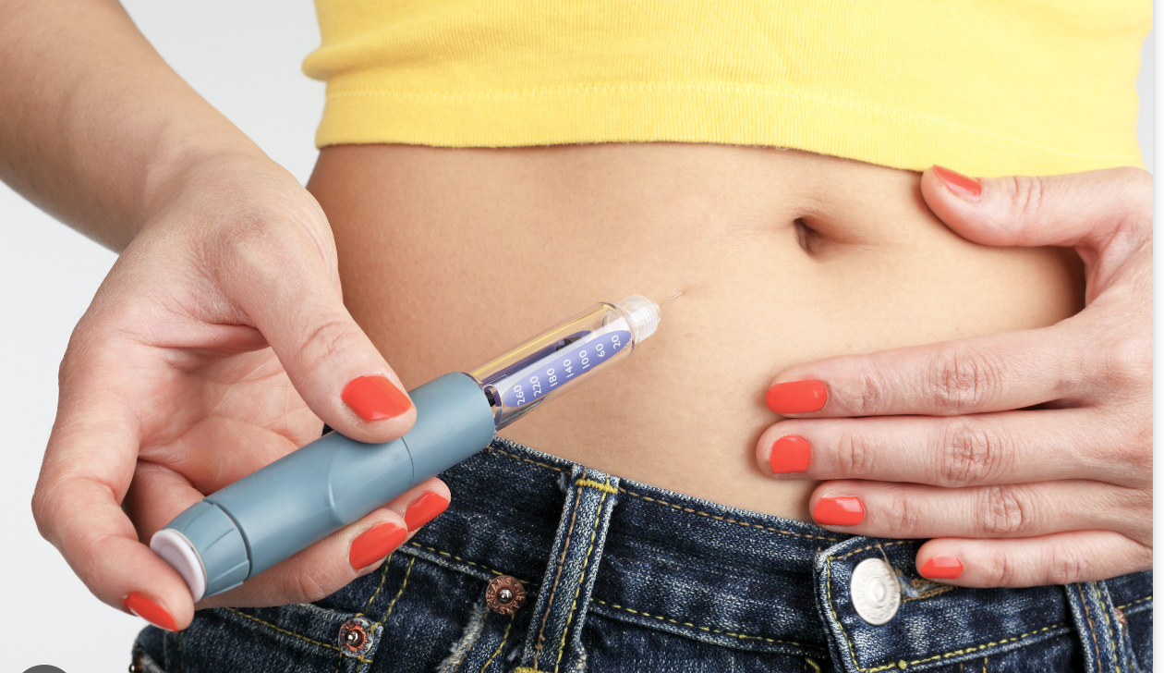
Insulin is ineffective
Type 2
Not enough insulin – type 1
Notes:
There are two types of diabetes: type 1 (not enough insulin) and type 2 (ineffective insulin). People with type 1 need insulin injections or pumps, while those with type 2 may need to eat healthy, exercise, and sometimes take medicine.
People with diabetes need to be careful about their blood sugar levels by checking them regularly with a glucose meter. They should eat healthy, exercise, and take prescribed medicines to keep their blood sugar in the right range.

Slide 8
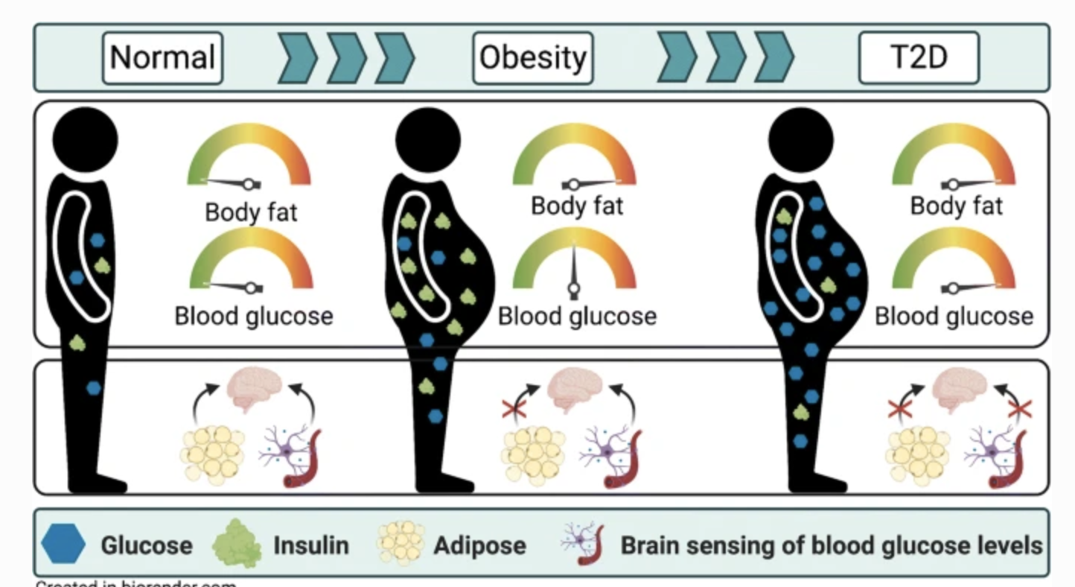

Slide 9

Machine Learning Workflow Five Stages: 1. Gathering Data 2. Pre-Processing Data 3. Researching the model that would fit best for the type of data 4. Training and testing the model 5. Evaluating

Slide 10
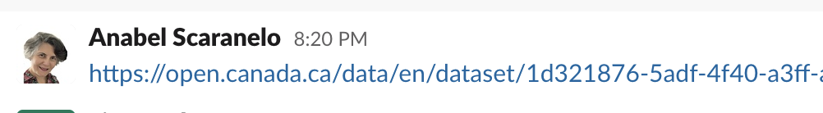
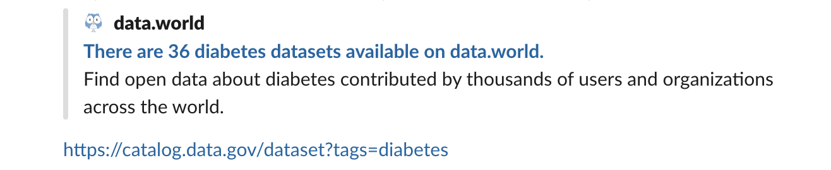
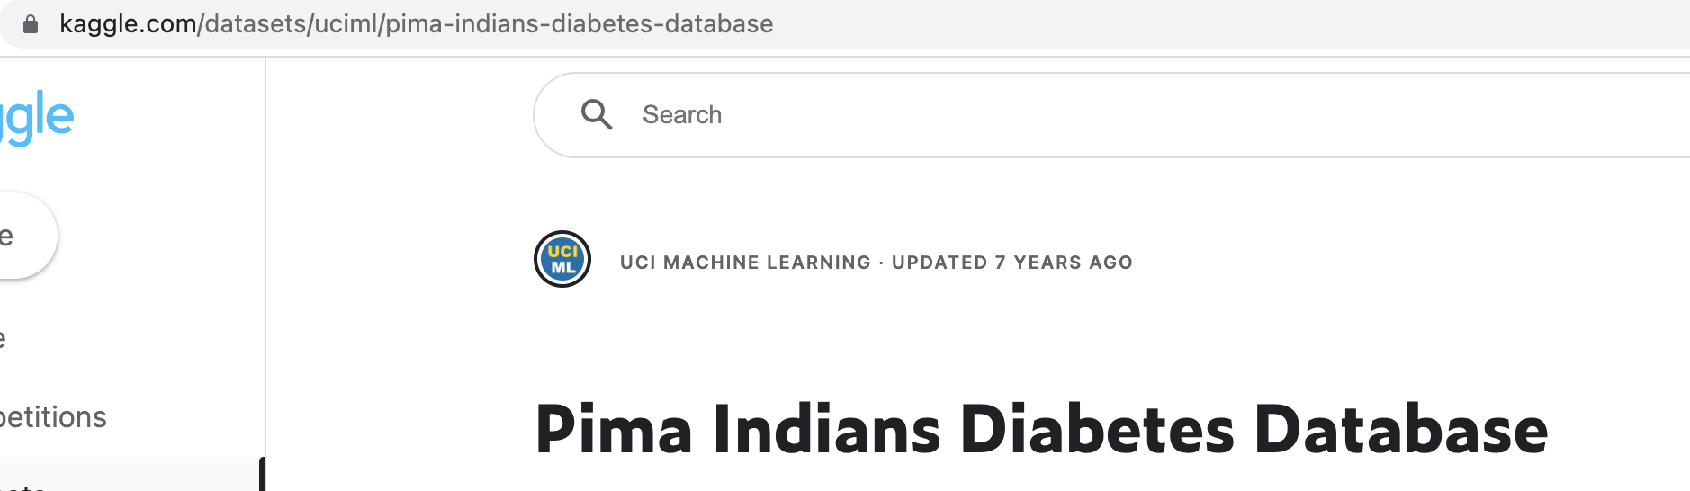
1. Gathering the Data

Slide 11

About the dataset
The Pima are American Indians that live along the Gila River and Salt River in Southern Arizona.
We used the Pima Indian dataset, made available by the National Institute of Diabetes at the Johns Hopkins University.

Slide 12
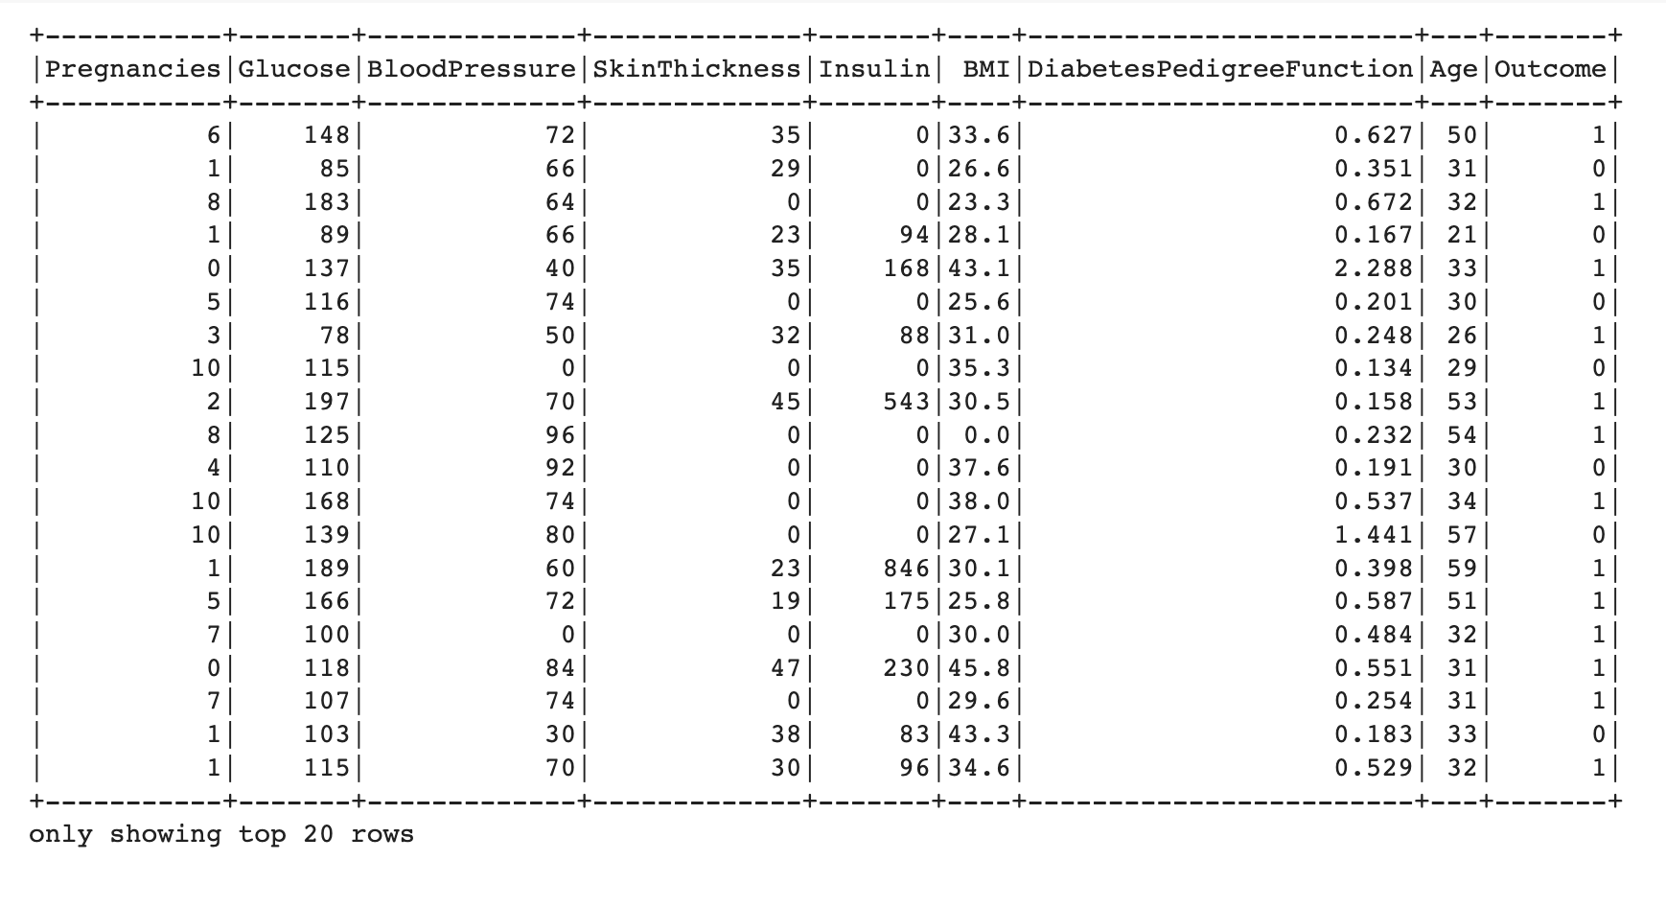
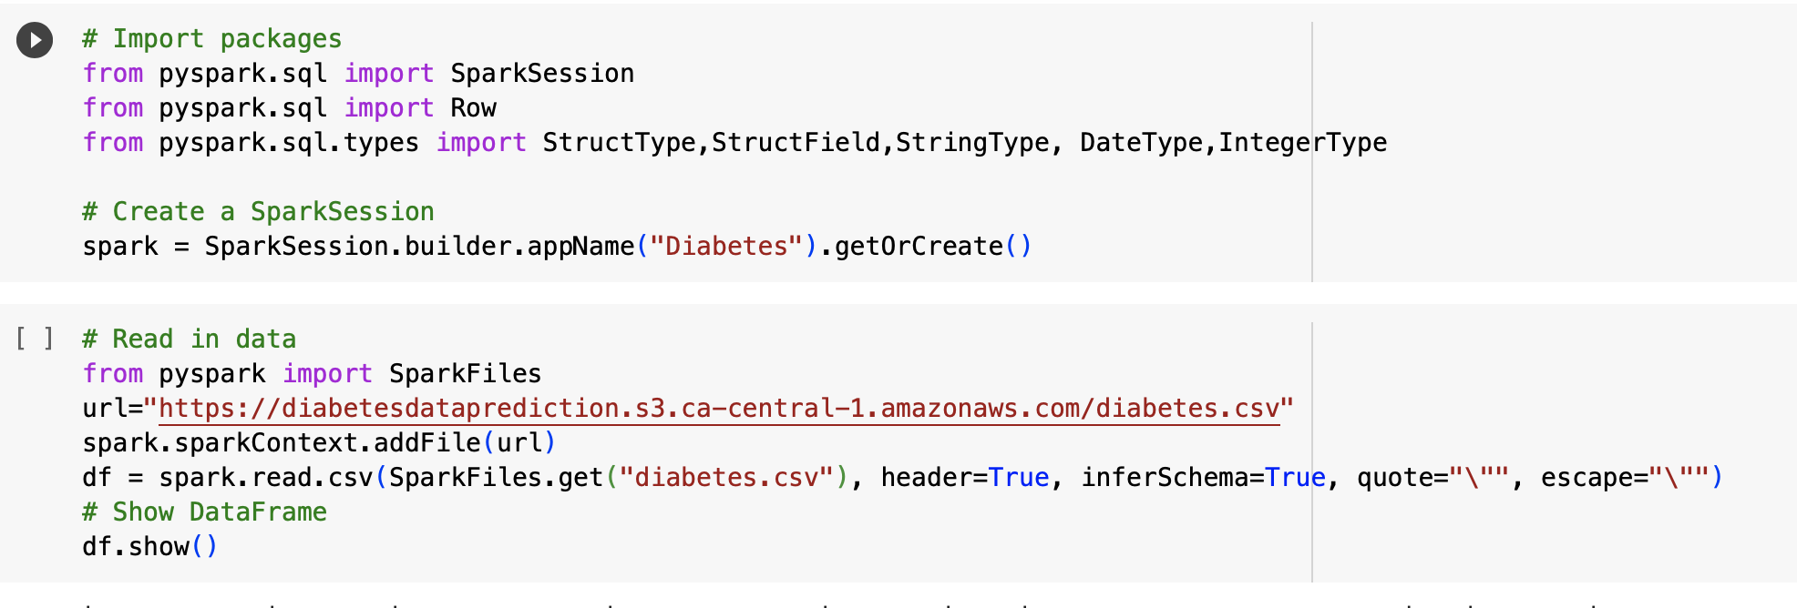
Data imported using Spark

Slide 13
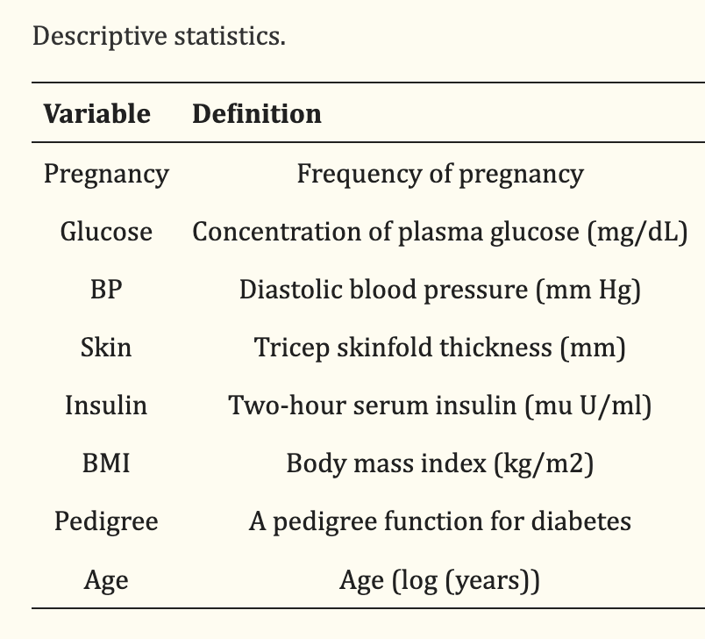
Features in the Dataset

Slide 14
Diabetes Data imported using Spark

Slide 15
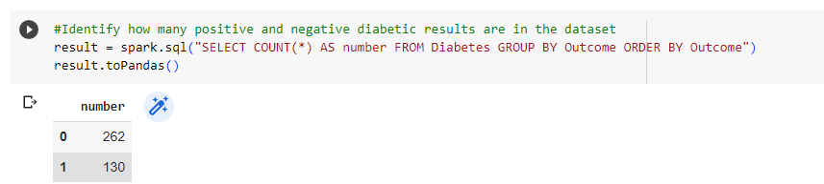
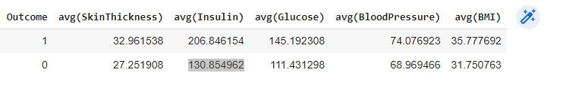
Data Pre-Processing
2. Exploratory Data Analysis
For both Diabetic and non-Diabetic Instances, Average of each of the features are calculated.

Slide 16
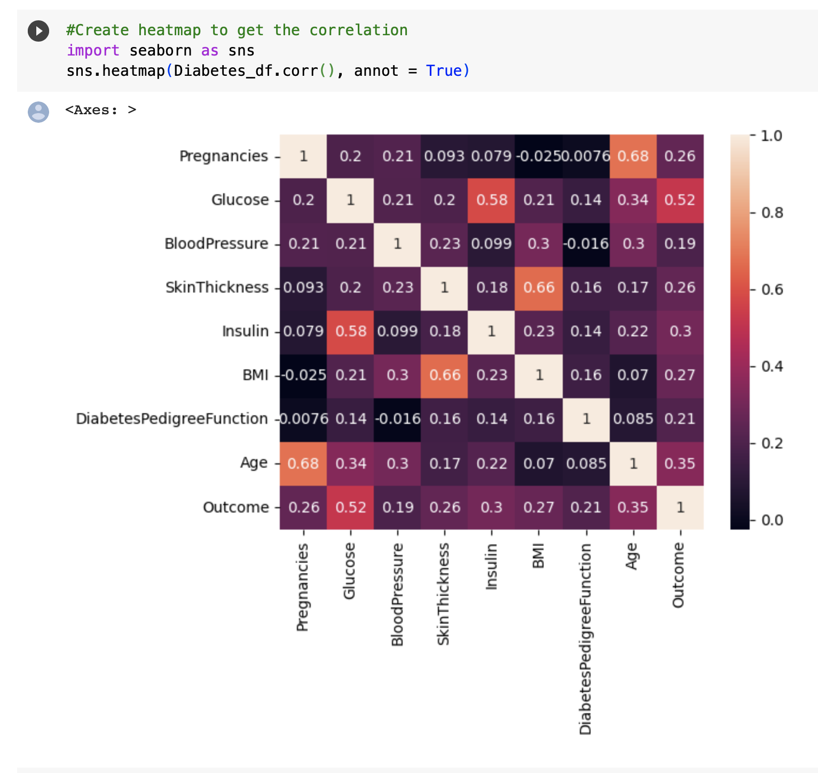
Visualizations
Correlation Matrix
(Heat Map)

Slide 17
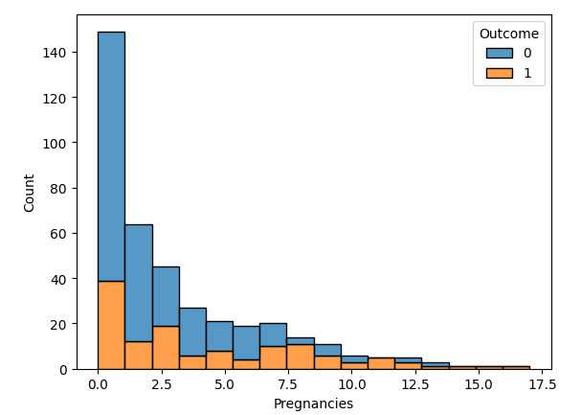
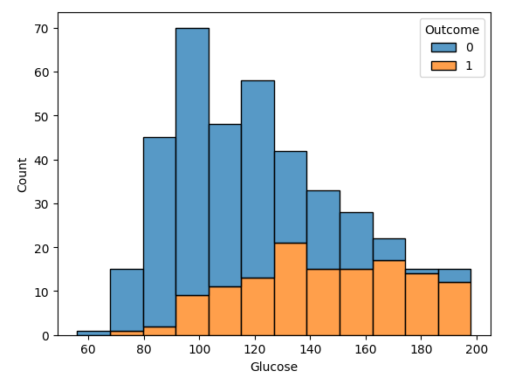
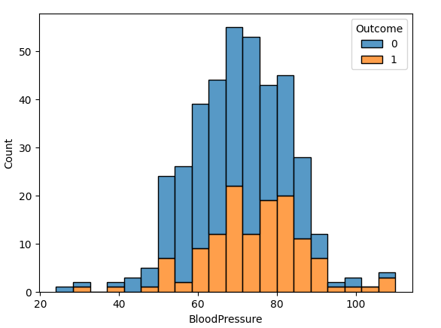
Plot of Each Features against the Outcomes (Diabetic or Non-Diabetic)
Pregnancies
Glucose
Blood Pressure

Slide 18
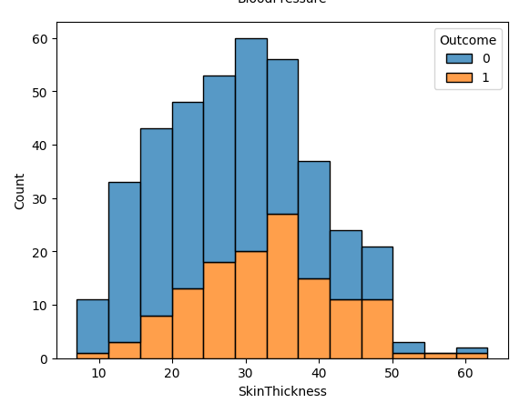
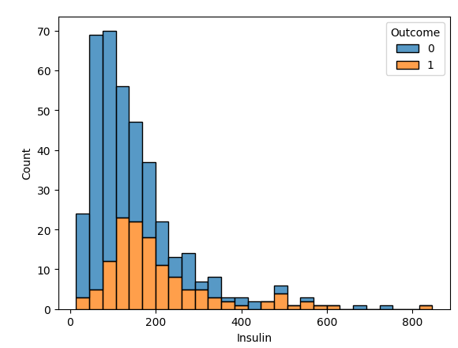
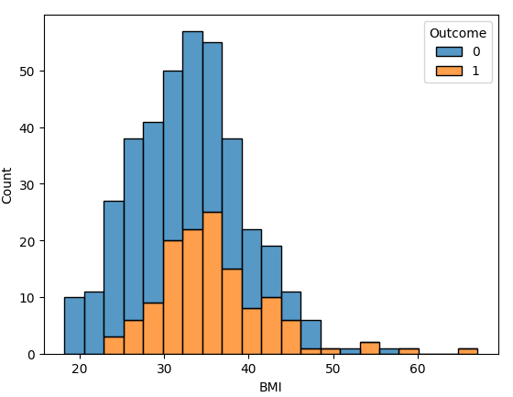
Plot of Each Features against the Outcomes (Diabetic or Non-Diabetic)
Skin Thickness
Insulin
BMI

Slide 19
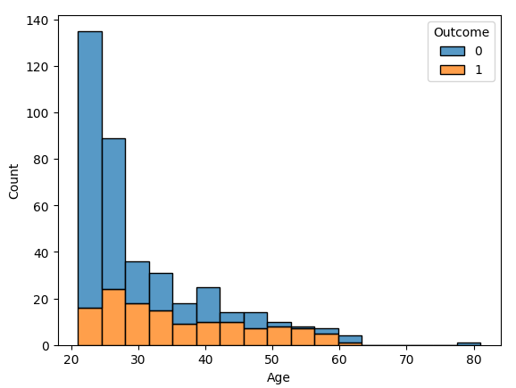
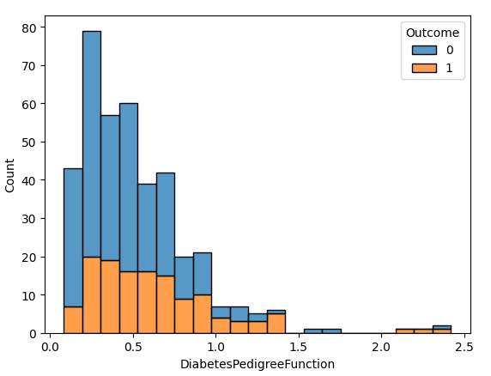
Plot of Each Features against the Outcomes (Diabetic or Non-Diabetic)
Age
Diabetes Pedigree Function

Slide 20
3. Researching the most appropriate models
1. Logistic Regression
2. Random Forest Classifier
3. K-Nearest Neighbor
4. Support Vector Machine

Slide 21
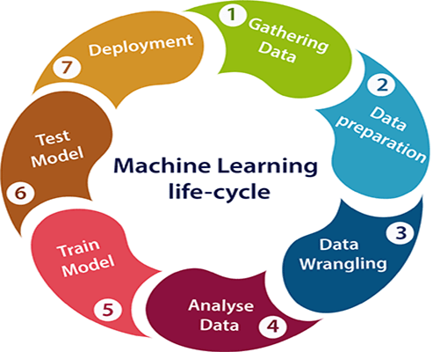
Building the ML Models
Split Data to Training and Testing Data sets
Build Model on the Training Data
Make predictions using Test Data
Evaluate
Accuracy, Classification Report

Slide 22
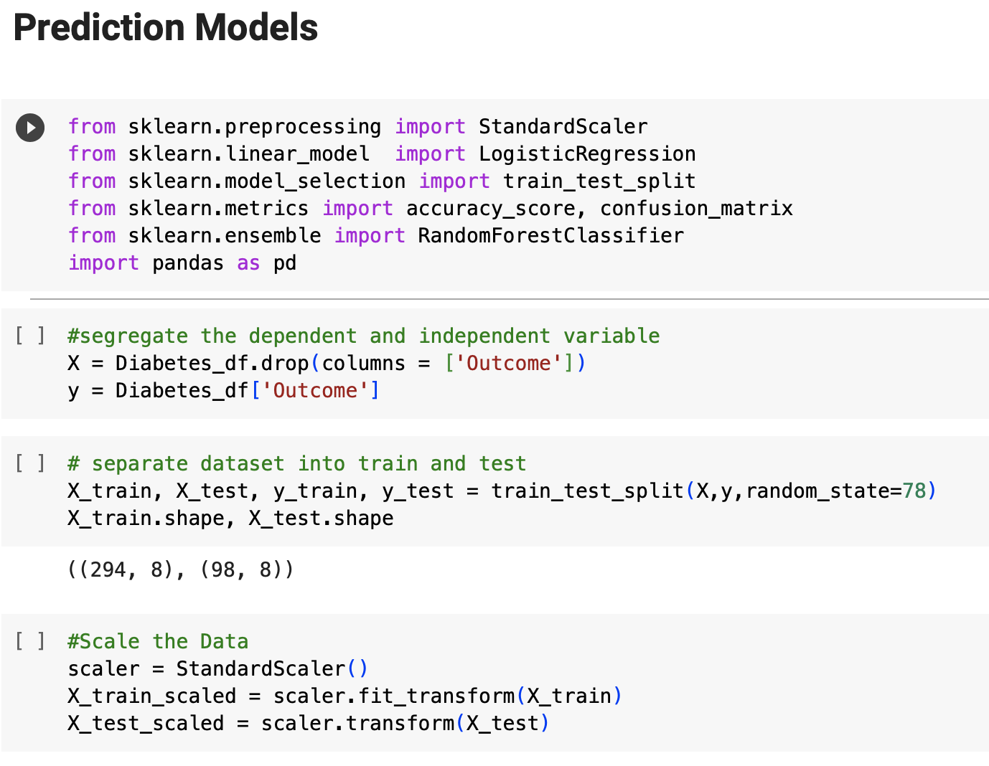
Training and testing the models

Slide 23

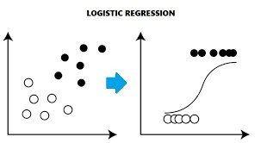
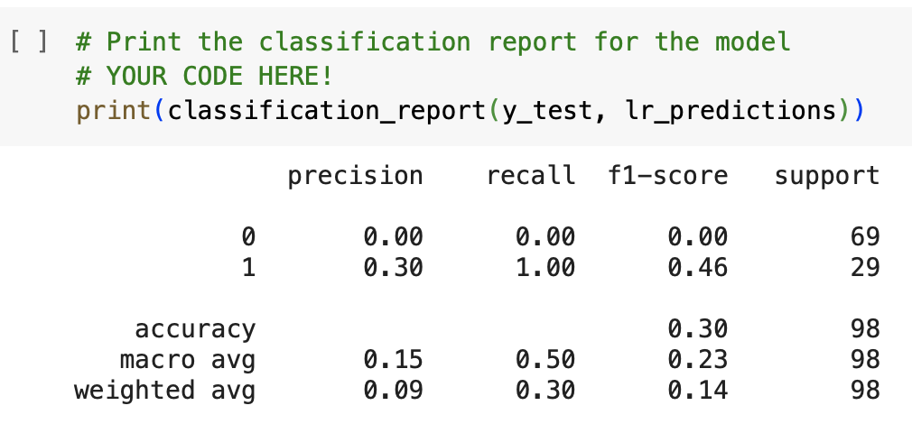
Logistic Regression Model

Slide 24
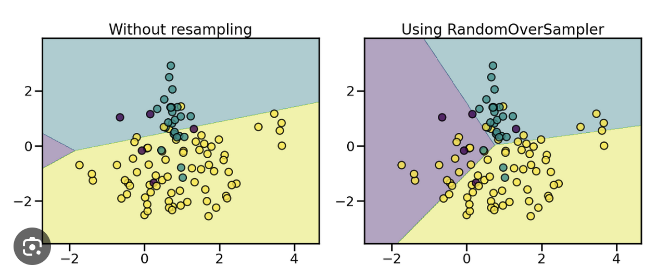
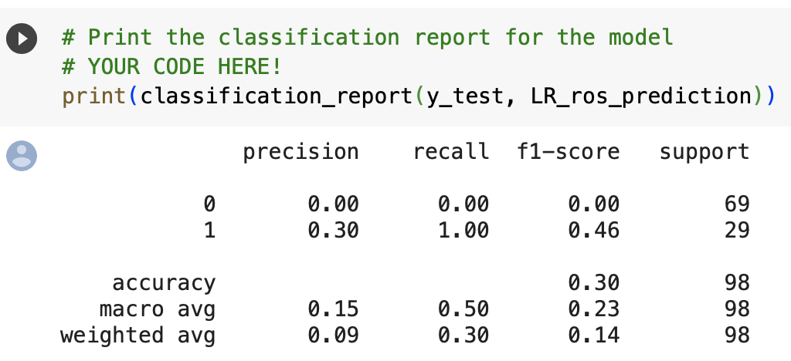
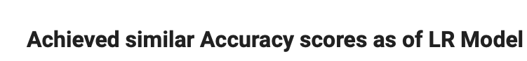
Logistic Regression Model Using Resampled Data

Slide 25
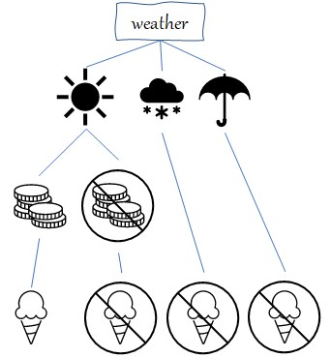
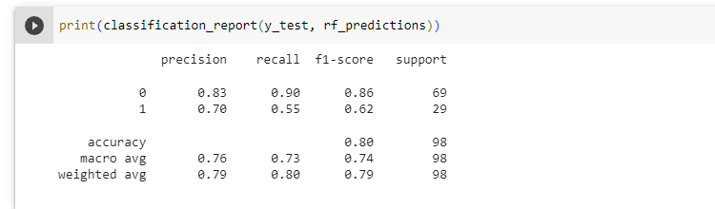
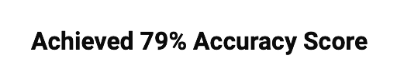
Random Forest Classifier Model
80%

Slide 26
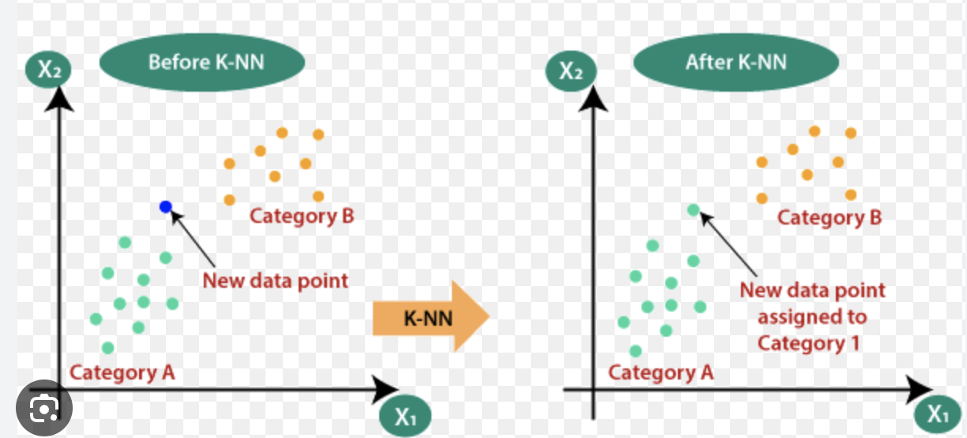
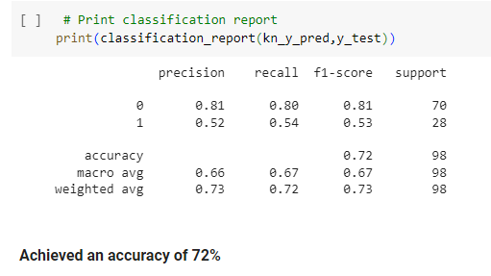
K-Nearest Neighbours Model

Slide 27
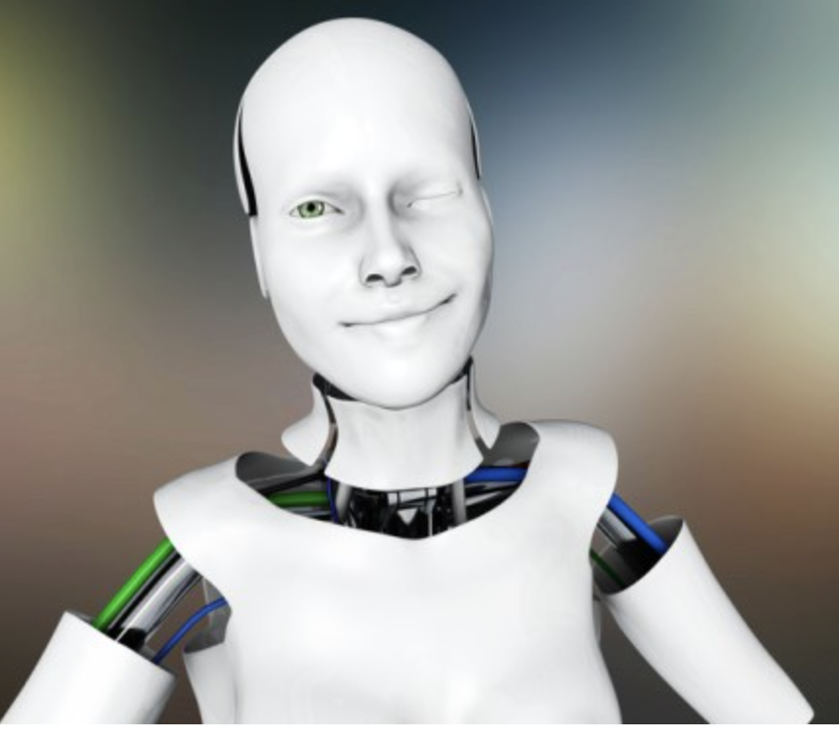
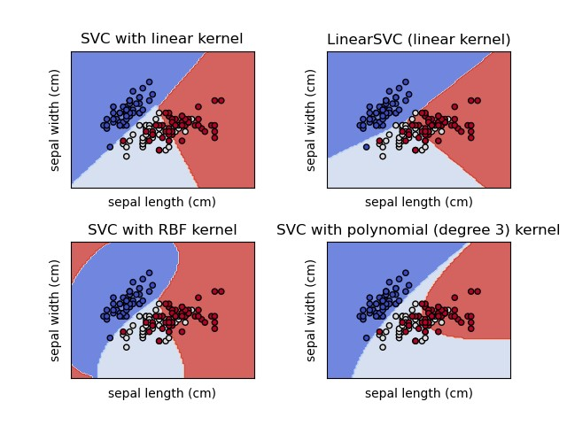
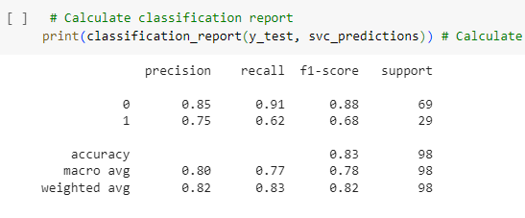
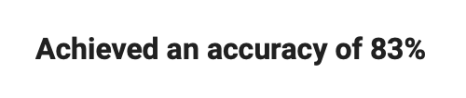
Support Vector Classifier Model

Slide 28

Limitations
Limited variables used to predict diabetes risk may limit the applicability of our results due to data constraints. Larger datasets with more variables may yield different outcomes.
We excluded the missing values in the data, which despite of being a usual practice, it could modify the results.

Slide 29
Conclusions
Identifying subjects at high risk of developing diabetes is a critical component of disease prevention.
We identified the critical variables in predicting type 2 DM, which are BMI, age, skin thickness and multiple pregnancies in women.
We built the model using some machine learning algorithms such as Logistic Regression, Random Forests, K-Nearest Neighbor (KNN) and Support Vector Machine (SVM) and we conclude that our proposed model has a prediction accuracy of 83%
The best accuracy was achieved with SVM.

Slide 30
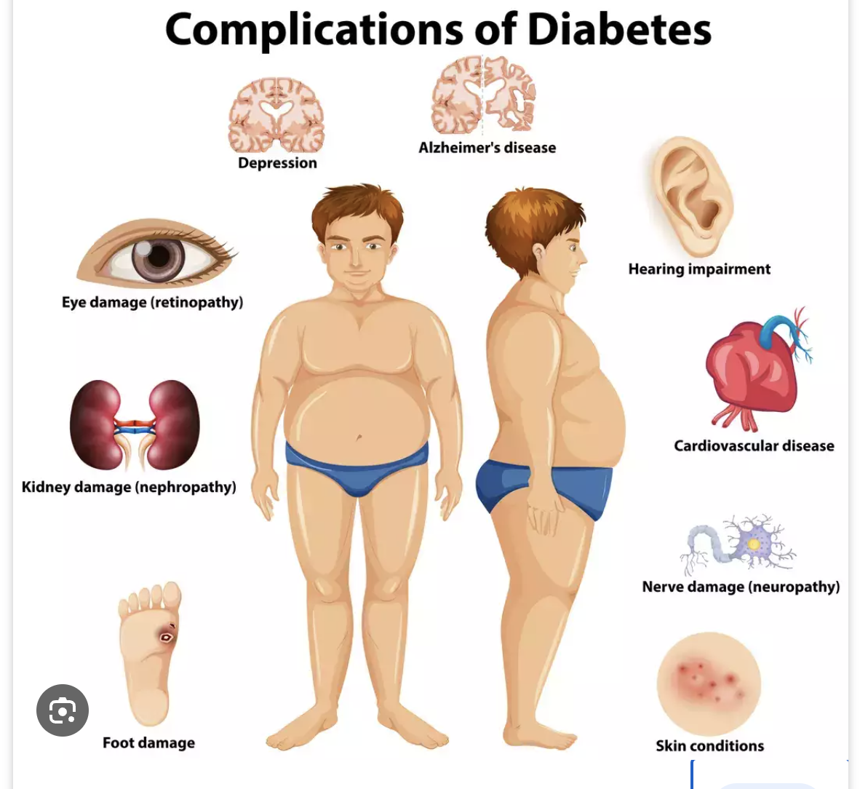
You don’t want to get this nasty disease!
Please Eat well,
Be physically active,
Maintain a healthy weight,
Live tobacco-free
Manage Stress.

Slide 31

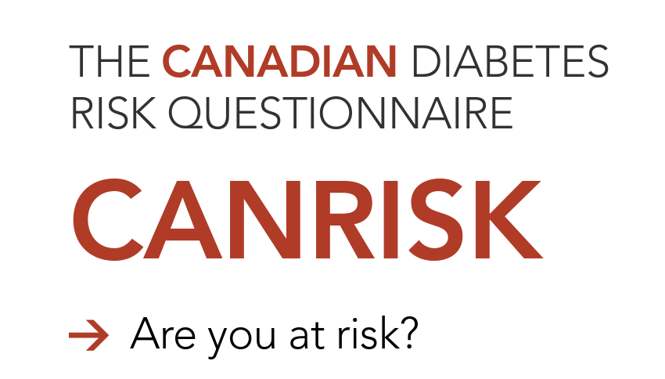
https://www.healthycanadians.gc.ca/en/canrisk

Slide 32




